Slide 1
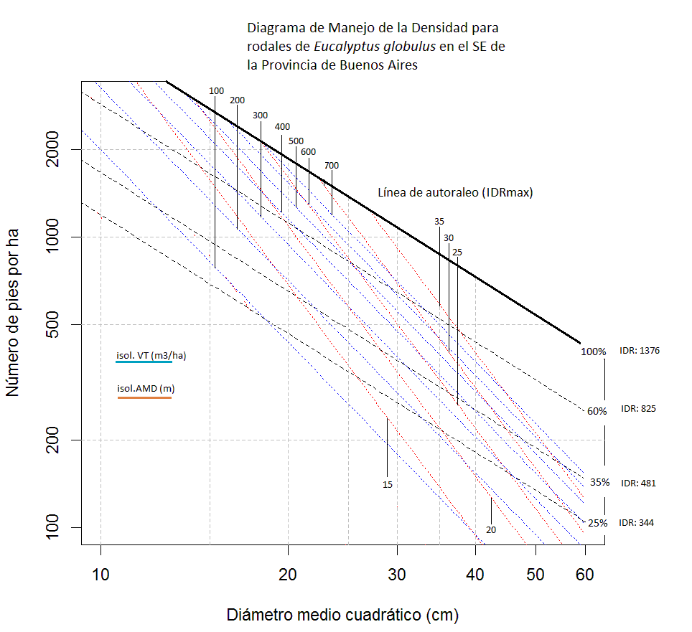
R (a)

Slide 2
R (b)

Slide 3
R (c)

